Slide 1



Backorder Prediction
Team Member: Sherrie Liu/ Robin Liu/ Minyao Xu/Phani Uppu

Slide 2
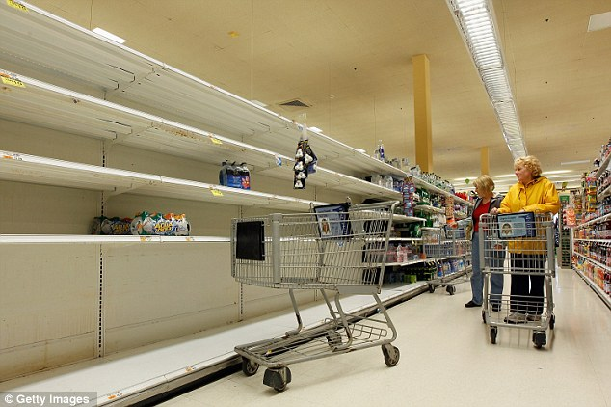
Out of Stock

Slide 3
CONTENT
Business
Understanding
Data
Preparation
Modeling
Evaluation
Deployment

Slide 4

Backorder
An order that currently cannot be filled or shipped. Suppliers still allow retailer to order but will ship later when the stock is back to normal
Notes:
Imagine you’re selling and you’re selling a lot; your product is flying off the shelves so quickly that you can’t keep up with the demand. Now you’ve got two choices: Disappoint your customers and tell them that you’re out of stock, or open a backorder.

Slide 5
1
Backorder Process
Customer’s order
Backorder
SUPPLIER
Product A
Product A Product B
RETAILER
Product B
Product B

Slide 6
CONTENT
Business
Understanding
Data
Preparation
Modeling
Evaluation
Deployment

Slide 7
1
Task and Why?
Task: Predict if an order would be a backorder
More Time to React
No guarantee retailer will keep the order
Retailer can order in advance
$11-$15 cost /backorder
Better Business
Planning
According to one study from Fedex, on average, a backorder will cost supplier $11-$15, not even including some further impacts on business relationships and sales
Potential to adjust demand forecast and production plan for certain items to decrease chance of backorders
Notes:
Working to identify parts at risk of backorder before the event occurs so the business has time to react.

Slide 8
CONTENT
Business
Understanding
Data
Preparation
Modeling
Evaluation
Deployment

Slide 9
2
Data Description
Data Source
Kaggle— Can You Predict Product Backorders?
Training data：1,687,861 instances
Test data： 242,076 instances
Training data： historical data for 8 weeks prior to the week we are trying to predict.
Content
Target variable: Product actually went on backorder
Features: 22 features
Inventory/Transit time/Actual sales over periods/Forecasted sales over period/Previous shipping performance/Risk Flag
Variables

Slide 10
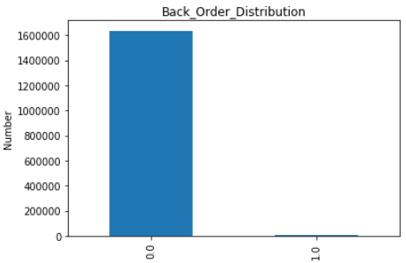
2
Data Exploration—Challenges
Missing Values
Unbalanced Dataset
Column: lead_time
Transit time for product
Training set: 6.0%
Test set: 6.1%
Column: perf_6_month_avg
Performance for prior 6 months
Training set: 7.7%
Test set: 7.9%
Column: perf_12_month_avg
Performance for prior 12 months
Training set: 7.2%
Test set: 7.4%
Target Variable
No—product did not go on backorder: 99.4%
Yes—product actually went on backorder: 0.6%

Slide 11
2
Data Exploration—Dealing with Missing Values
Missing Values
Solution: use other variables and regression/classification techniques to predict missing attributes
Reason: Not Missing Completely at Random (MCAR)
Completed Dataset
(without NAs)
Predict the missing attributes
Using ensemble methods
Original Training Dataset
Dataset
Containing NAs
of Attribute A/B/C
Dataset with
Predicted Values
of Attribute A/B/C
Non-completed Dataset
(containing NAs)
Dataset
without NAs
in Attribute A/B/C
Combine
Cleaned
Dataset

Slide 12
2
Data Exploration—Dealing with Unbalanced Dataset
Unbalanced Dataset
Problem
Models tend to predict the majority class all the time, causing meaningless high accuracy.
When sampling instances from the training set, there’s a good chance no minority class will exist in the sample at all.
Solution
Oversampling—Repeat sampling instances in the minority class with replacement.
Result
Adaboost algorithm and neural network work better when trained on a balanced set.
Recalls are doubled, from 0.04 to 0.1.
Auc is significantly increased, from 0.8 to 0.92 for adaboost and 0.6 to 0.91 for neural network.

Slide 13
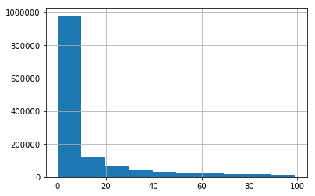
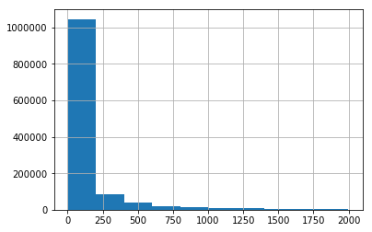
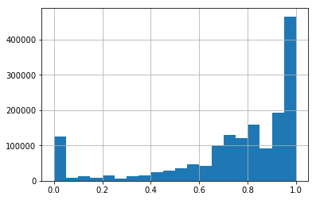
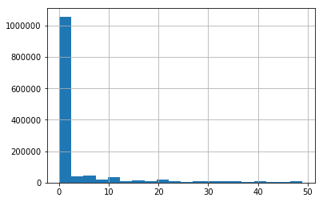
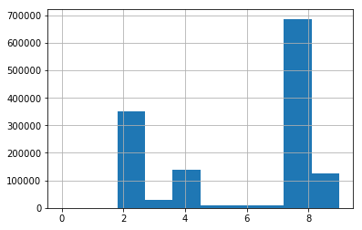
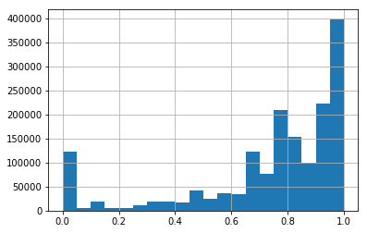
2
Data Exploration—Features Distribution
Previous 9 Months Sales
(80% below 100 units)
Current National Inventory
(75% are below 2000 units)
Previous 6 Months Shipping Performance Distribution
Next 9 Months Sales Forecast
(80% below 50 units)
Current Lead Time
(83% are below 10 weeks)
Previous 12 Months Shipping Performance Distribution

Slide 14
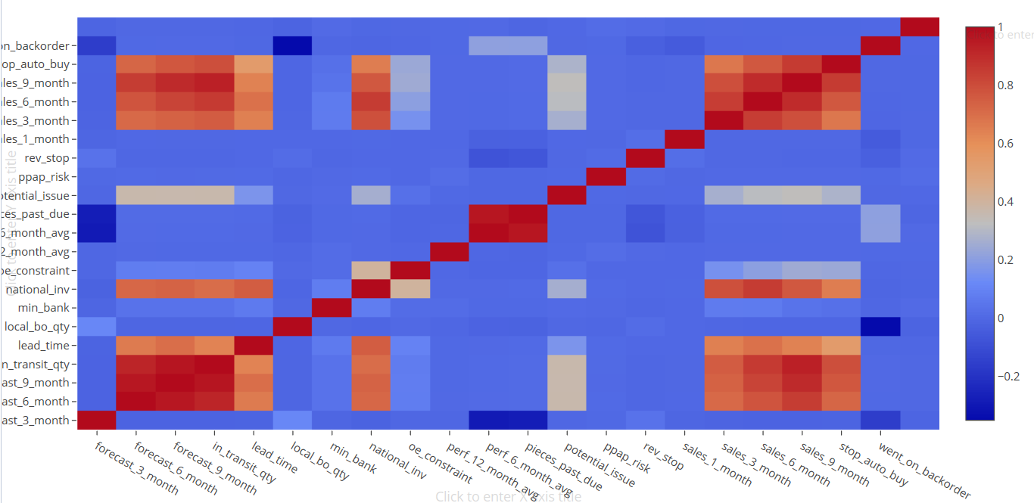
2
Data Exploration—Correlation
Correlation Among Variables
Target Variable & Features
‘Went on backorder’ is not highly correlated with any of the features.
Among Features
Amount of quantity in transit from source/ transit time for product/ the forecast sales/ past sales are correlated.
Adaboost and neural networks
can handle the problem!

Slide 15
CONTENT
Business
Understanding
Data
Preparation
Modeling
Evaluation
Deployment

Slide 16
3
Model Building
Split Data
Choose Model
Train Model
Ensemble
Divide the training dataset into 7 subsets
Because the original dataset is too large and computational hard
Neural network Adaboost Random forest
Train 3 models on 7 subsets respectively—21 models in total
Do grid search on each model to find the best parameters
Ensemble results of 21 models
by calculating their average predicted probability or weighted average probability

Slide 17
CONTENT
Business
Understanding
Data
Preparation
Modeling
Evaluation
Deployment

Slide 18
4
Model Evaluation—Performance Metrics
 | AUC | F1-Score | Recall | Precision | Accuracy
Ensembled | 0.94 | 0.32 | 0.24 | 0.50 | 0.98
Adaboost | 0.93 | 0.20 | 0.63 | 0.63 | 0.94
Neural Network | 0.93 | 0.20 | 0.69 | 0.69 | 0.94
Random Forest | 0.92 | 0.30 | 0.30 | 0.31 | 0.98

Slide 19
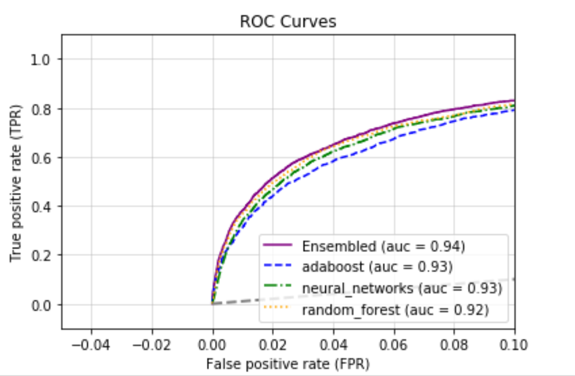
4
Model Evaluation—ROC curve
The current Best Performance on Kaggle is around 0.95
The auc of ensembled model is best—0.94

Slide 20
4
Model Evaluation—Cost and Benefits Analysis
Benefits
Cost
True Positive
Predicting correctly backorders
Benefits: better reaction time/better production planning /order in advance if necessary
False Positive
Predicting backorders but in reality they are not
Costs: warehousing costs/potentially damaged products
True Negative
Predicting not in backorders correctly
Benefits: No extra costs
False Negative
Predicting NOT backorders but in reality they are
Costs: warehousing costs/packaging costs/potential sales loss

Slide 21
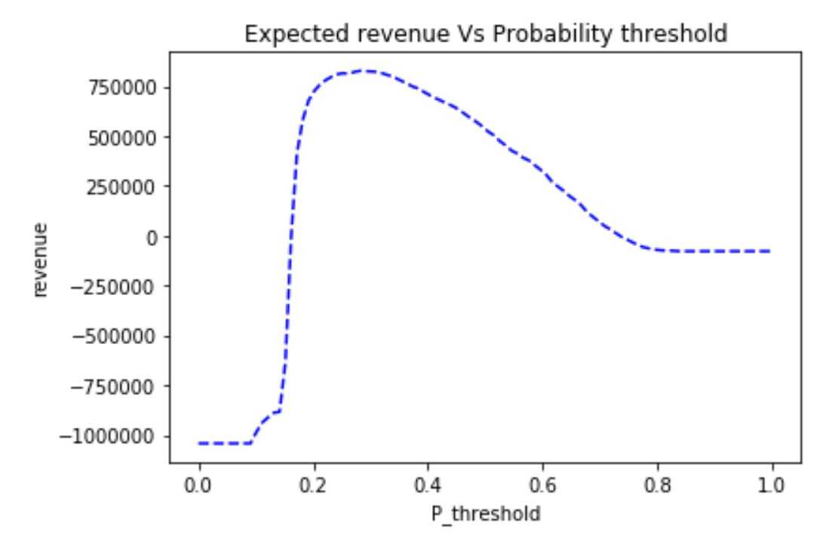
4
Model Evaluation—Cost and Benefits Analysis
Notes:
This is a plot of probability threshold vs potential revenue when we consider risk and revenue associated with a classifier. A more aggressive retailer who’s willing to take more risks might accept a classifier with lower threshold hoping by capturing more backorder it will bring more revenue. Whereas a more conservative retailer might predict backorder when probability is high enough. This will decrease its potential revenue but at the same time lead to lower risk.
x axis represents the change of threshold for different classes
y axis represents an

Slide 22
CONTENT
Business
Understanding
Data
Preparation
Modeling
Evaluation
Deployment

Slide 23
5
Model Deployment
The model can be incorporated into the current ordering system of the supplier and retailer.
With new ordering/ inventory data feed in every day, the prediction of backorder updates daily.
Retailers and suppliers can pick models/classification threshold depending on the following criteria:
type of retailer(aggressive/conservative)
type of products(perishable/non-perishable)
alignment between retailer and suppliers
The alignment sometime can be hard to achieve between retailers and suppliers as different parties have different business priorities and KPIs.

Slide 24
Thank you!
Any Questions?

